Slide 1
Matchmaker
Your Lifetime Partner Finder
UNC Data Analytics Bootcamp Final Project
By Chris Glessner, Chris McCown, Gilberto Ramirez, Ashok Singh – Oct 31 2019

Slide 2
Agenda
Project Overview
Extract-Transform-Load of Matchmaker Data
Machine Learning Models to find Matches
Matchmaker Project Demo
Next Steps

Slide 3
Project Overview
1994 Kiss.com
1995 Match.com
1997 Jdate
2000 eHarmony
2002 Friendster, Ashley Madison
2003 Proxidating
2004 OkCupid
2006 Badoo, SeekingArrangement
2007 Skout, Crazy Blind Date
2008 GenePartner
2009 Grindr
2011 LikeBright
2012 Highlight, Tinder
2014 Bumble
The Hero’s Journey of finding a partner.
Explosion in Online Dating last two decades.
The science behind Recommender Systems.
Evolution of Recommender Systems for online dating.
Our approach in this project.

Slide 4

About the Data
Matchmaker Data
Speed Dating Data.csv : Data based on experimental data collected by Columbia Business School at different times
Self demographics information e.g. Race, Gender, Age
Partner demographics information e.g. Race, Gender, Age
Self-assessment e.g. Attractiveness, Sincerity, Intelligence, Fun, Ambition
Partner Preference e.g. Attractiveness, Sincerity, Intelligence, Fun, Ambition
User Data
uinames.com API to get user profiles
Firstname, Lastname, Screenname, Gender, Age
Email, Password, Photo

Slide 5
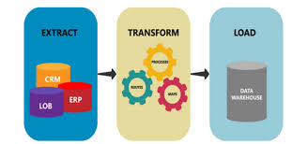
Extract Transform Load
Extracting the Data
Downloaded the Matchmaker Data, Speed Dating Data.csv from https://data.world/annavmontoya/speed-dating-experiment
Used API request to get User Data from https://uinames.com
Transforming the data
Focused on the key variables and reduced features of interest of matchmaker data
Reduced 195 columns to less than 20 columns
Correlated user and partner data
Got the data ready for machine learning models
Loading the Data
Created an AWS Posgres SQL Database
Uploaded Matchmaker and User data to AWS database
Added routes to access the database

Slide 6




Machine Learning Models to find best Matches
Tried different Machine Learning Models to determine best model
Logistic Regression Model
K Nearest Neighbors Model
Decision Tree Model
Random Forest
Support Vector Machine (SVM) Model
Deep Learning / Neural Network Model

Slide 7
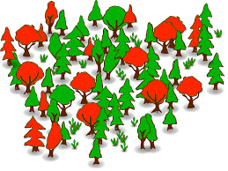
Building the Model
Building the Model
Get matchdata from AWS Postgres database
Prepare and format the data for the model
Separate the Train and Test Data
Run Random Forest Model to fit the train data
Use the test data to predict and validate model accuracy
Use confusion_matrix to find the accuracy of the model

Slide 8
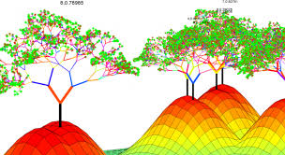
Using the Model to find Matches
Using the Model
Get current user data
Get opposite gender data from AWS Postgres database
Multiplex and prepare the data to run the model
Use the Random Forest Model to predict the Matches
Display the Matches

Slide 9
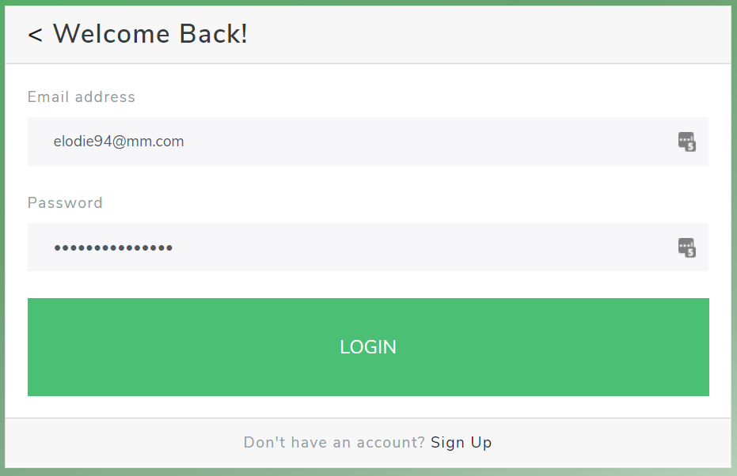
Login page
flask-login
Sample users:
John123@mm.com
password: John123
Jane123@mm.com
password: Jane123

Slide 10
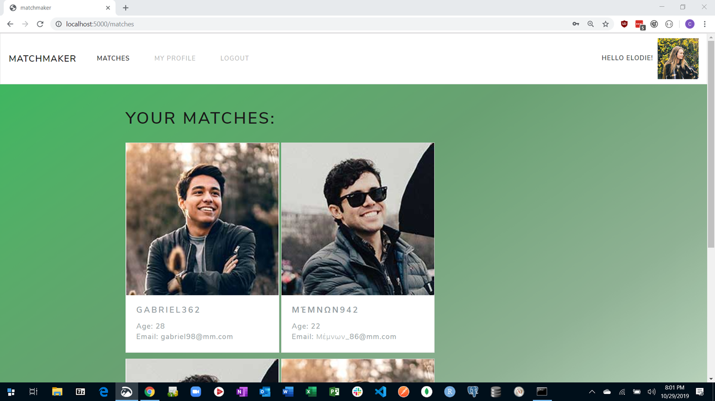
Matches page

Slide 11
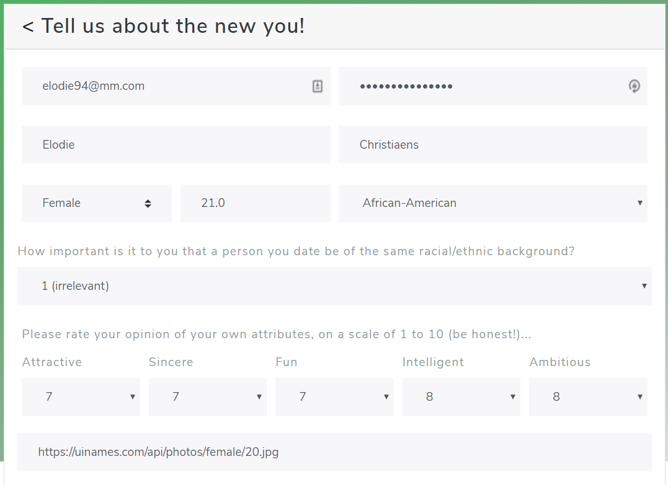
My Profile (/Sign Up) Page

Slide 12
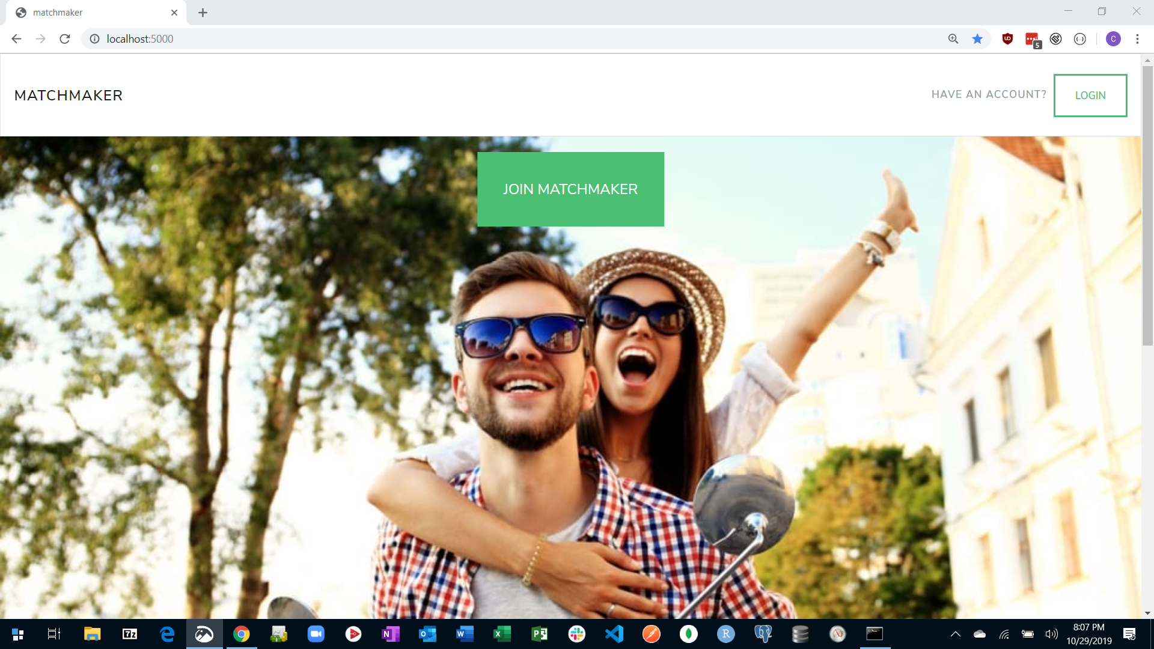
Logout

Slide 13
Next Steps
We need more data…
more users
more features
Need to employ more rigorous feature selection methods.
Continue to incorporate feedback from other users to inform the model.

Slide 14


https://unc-datavis-matchmaker.herokuapp.com/

